Slide 1


INDUSTRY BRIEFING · 2026
SALES & STRATEGY FOR BEER DISTRIBUTORS
The State of Sales Execution in Beverage Distribution
What four billion dollars in tracked sales reveals about the widening gap between the best distributor teams and everyone else.
$4B
2,500+
55+
100+
In sales tracked
Front-line reps
Distributors
Comp plans

Slide 2
THE PRESSURE ON THE FLOOR
Three pressures on every distributor sales team
01
02
03
Rep turnover keeps resetting the route
Execution still runs on spreadsheets
Reps don't know where they stand
The people who carry your customer relationships keep walking out the door. Every exit erases years of route knowledge that lived in one rep's head.
Objectives, incentives, and supplier programs live in tabs no one fully trusts — updated by hand, shared late, and out of date by the time they hit the street.
Ask a rep "how am I doing, and what matters next?" Most can't answer it on the spot — so the day gets sold on instinct instead of the plan.
02 / 07

Slide 3
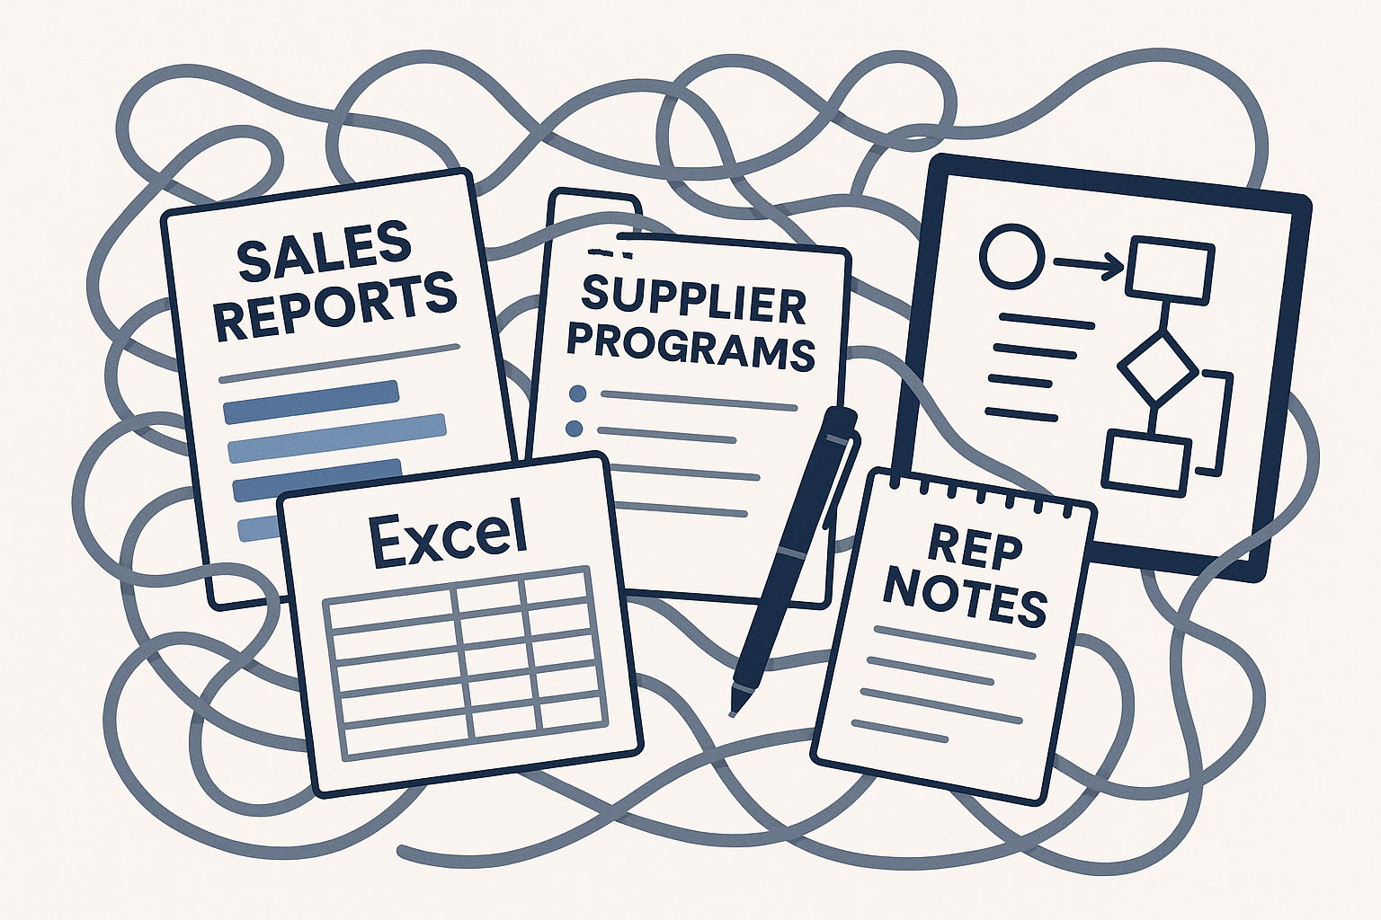
THE DATA PARADOX
More data than ever, less direction than ever
Sales reports, supplier programs, rep notes, spreadsheet after spreadsheet — the average distributor sits on more performance data than at any point in the industry's history.
~0%
of it reaches the rep on the route in a form they can actually act on before the next stop.
03 / 07

Slide 4
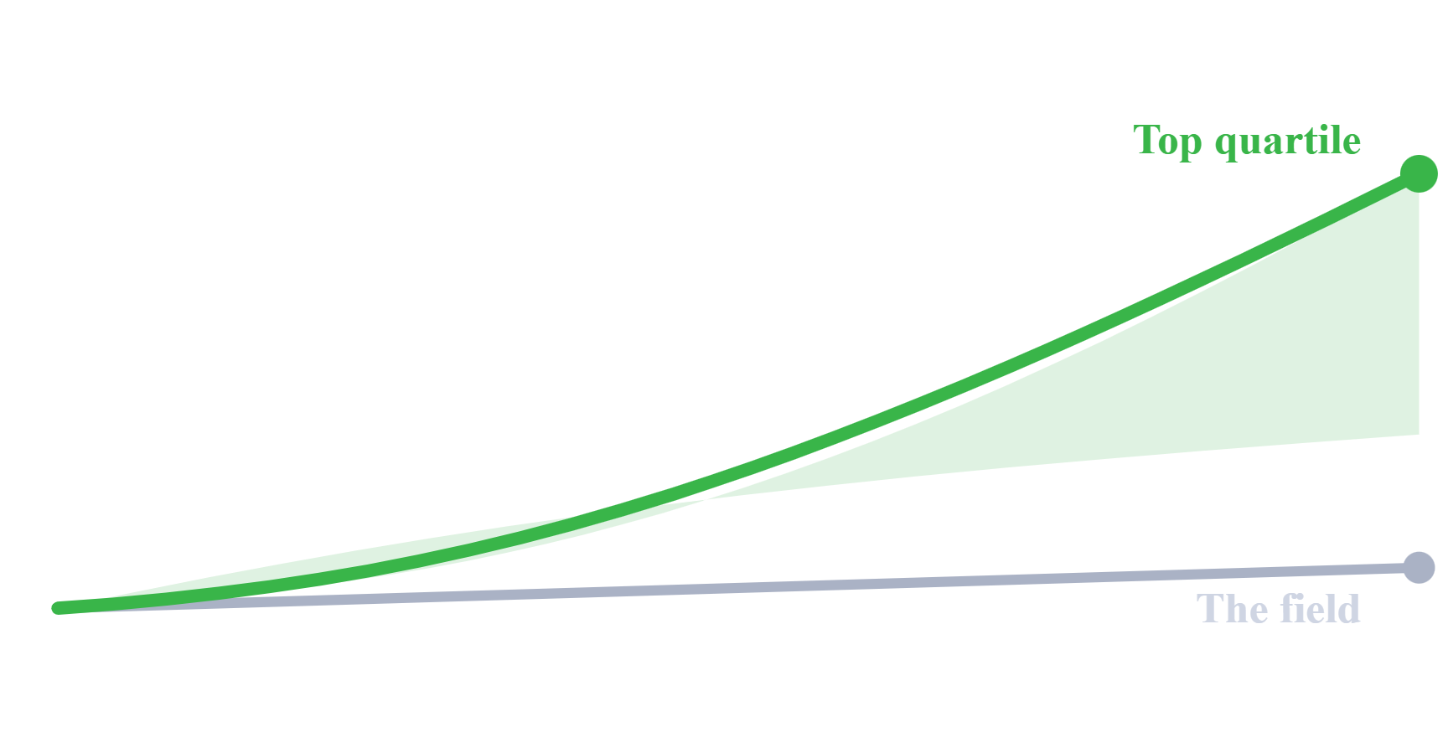
WHAT THE BENCHMARK SHOWS
The gap between top and average is widening
Top operators now grow gross profit faster than their price increases and faster than the premiumization their market is seeing. The field, running the old way, is standing still.
04 / 07

Slide 5
WHAT THE LEADERS DO DIFFERENTLY
What separates the top performers
A
B
C
Clear objectives, every period
They always know the score
They sell to profit, not just cases
Where they stand against goal — by gross profit, by volume, by route — is in their hand, updated daily, no one has to ask.
Every rep walks in knowing the two or three moves that matter right now — not a 40-tab workbook, just this period's plan.
Volume is the habit; gross profit per case is the scoreboard. The leaders manage the mix, and the margin follows.
05 / 07

Slide 6

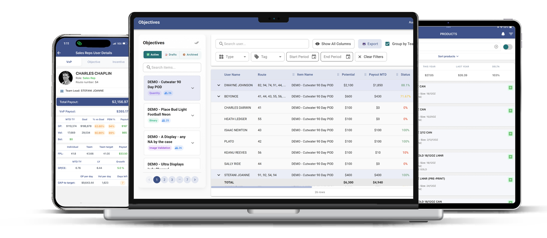
VXP turns execution into a system
The operating system top distributors run on — objectives, incentives, and profit targets in every rep's hand, scored daily.
+1.5 – 3%
faster gross profit growth for VXP clients — above their typical price-increase earnings, and above the premiumization their market is seeing. It falls to the bottom line faster.
06 / 07

Slide 7


THE NEXT STEP
See where your team sits against the field
Book a benchmark review. We'll show you how your sales model would look — and perform — inside VXP, measured against $4B in tracked distributor sales.
Book a benchmark review
Scan to start your review

